Slide 1
SIEMs and EDRs
Lathan Birmingham
CYBR 440 – Intrusion Detection and Response

Slide 2
Overview
SIEM
Security Information and Event Management
EDR Tool
Endpoint Detection and Response tool
Forensics Tool
Remotely capture memory and disk images
Notes:
Today I will be touching on 3 recommendations that are guaranteed to improve our company’s response to cybersecurity incidents.
My first recommendation involves utilizing SIEM technology, which is an acronym for security information and event management.
My second recommendation is utilizing an EDR Tool, which is an acronym for Endpoint Detection and Response.
My final recommendation is utilizing a forensics tool that can remotely capture both memory and disk images of a computer’s hard drive.
The specific brands of these 3 tools were picked with two concepts at the forefront – efficiency and affordability. Before I get to ahead of myself, Let’s dive deeper into each tool.

Slide 3

What is a SIEM and why is it important?
SIEMs use AI to automate the manual process of threat detection and incident response.
Purposes:
Monitor and analyze events in real time
Track and log security data for compliance and auditing
SIEM solutions allow organizations to efficiently collect and analyze log data from all their digital assets in one place. This gives them the ability to recreate past incidents or analyze new ones to investigate suspicious activity and implement more effective security processes.
- IBM, 2022
Notes:
So, before I tell you which exact SIEM I’d like to recommend, let’s answer the question – what is a SIEM and why is it important? SIEM is a technology that utilizes artificial intelligence and machine learning to automate the manual process of threat detection and incident response. With the ever-evolving threat landscape, SIEMs are now a staple in SOCs. Human error will always be a risk, utilizing a SIEM that automates manual processes means that our organization is much less likely to miss suspicious events that could potentially result in a cybersecurity incident.

Slide 4
IBM Security QRadar XDR
Highly scalable self-managing database
Automatically parses and normalizes logs
Deployments for cloud, on-premises, and as a managed service
Generates compliance reports for ISO 27001, PCI DSS, NIST RMF 800-53
Highlights
Notes:
The IBM Security QRadar XDR SIEM is a highly-scalable, self managing database that will remove the need for database administrations so our security team can focus on other operations. IBM XDR automatically parses and normalizes logs, requiring little to no manual effort. Since our company utilizes a hybrid work setting, we can utilize the cloud deployments as well as the on-premises deployments. By generating our required compliance reports through IBM Security QRadar XDR, our reports will become more accurate, and our security auditing team can spend less time generating the reports and more time focusing on how we can improve our audit reports.

Slide 5
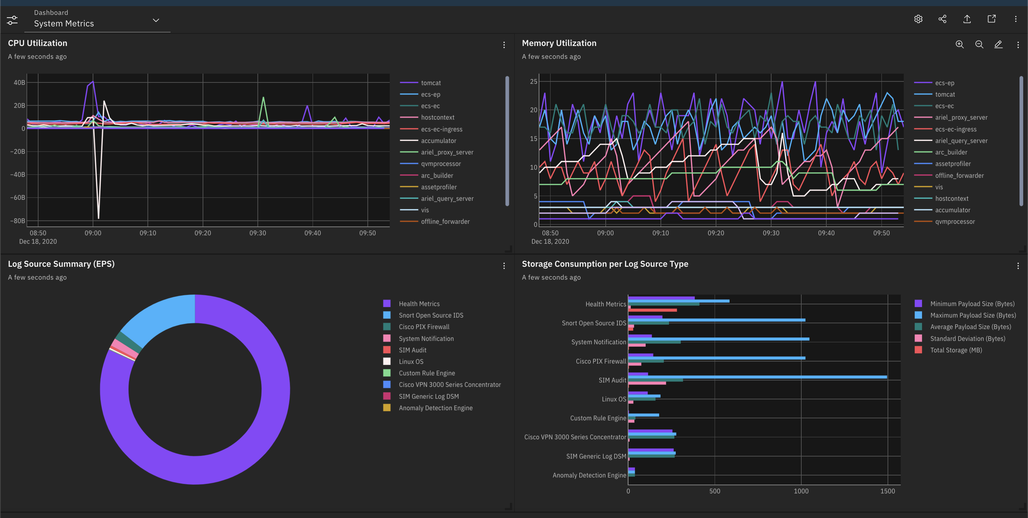
Notes:
Here is a screenshot of the IBM Qradar XDR. There are many other analytics from IBM QRadar that are not pictured on this dashboard.

Slide 6
IBM Security QRadar XDR Pricing
2-week free trial for Qradar Cloud edition
Exact purchase price available during a consultation with IBM sales representative
According to g2.com, pricing for IBM Qradar on Cloud standard starts at $800 per month
Notes:
Investing in a SIEM is rather expensive, on average it ranges anywhere from $20,000 up to $75,000, however I would like to stress that utilizing a SIEM could prevent a data breach that could potentially cost millions. One of the main reasons I chose IBM Security QRadar XDR is because they offer a 2-week trial period where we can determine whether we would like to continue with this SIEM or try another one. If we would like to continue with this SIEM, according to online sources, pricing will start at approximately $800 per month.

Slide 7
What is an EDR Tool and why is it important?
EDR tools uses machine learning and AI models to detect threats from any source, including managed and unmanaged devices.
Purposes:
Records networks, events, processes, files, commands and other data points
Searches for indicators of compromise
Determine root cause of detection and investigate
EDR security solutions analyze events from laptops, desktop PCs, mobile devices, servers, and even IoT and cloud workloads, to identify suspicious activity. They generate alerts to help security operations analysts uncover, investigate and remediate issues. EDR tools also collect telemetry data on suspicious activity and may enrich that data with other contextual information from correlated events. Through these functions, EDR is instrumental in shortening response times for incident response teams, and ideally, eliminating threats before damage is done.
- Palo Alto Networks, 2022
Notes:
Let’s move on to the EDR Tool. As I mentioned before, EDR stands for endpoint detection and response, which is exactly what an EDR tool does - it automates some of the more manual aspects of endpoint detection and response using machine learning and artificial intelligence. The purpose is to record network events, processes, files, commands, and many other data points. From here, it searches for indicators of compromise, and if compromise is detected, it will work to determine the root cause of the detection and finally will investigate that root cause. I would like to share a quote from Palo Alto Netoworks – “EDR security solutions analyze events from laptops, desktop PCs, mobile devices, servers, and even IoT and cloud workloads, to identify suspicious activity. They generate alerts to help security operations analysts uncover, investigate and remediate issues. EDR tools also collect telemetry data on suspicious activity and may enrich that data with other contextual information from correlated events. Through these functions, EDR is instrumental in shortening response times for incident response teams, and ideally, eliminating threats before damage is done.”

Slide 8
Cortex XDR – Palo Alto Networks
Safeguard endpoints with NGAV, host firewall, disk encryption and USB device control
Using advanced ML and behavioral analytics, detect hidden threats such as insider abuse, credential attacks, malware and exfiltration
Quickly verifies threats by determining root cause, sequence of events and investigative details
Block fast-moving attacks, isolate endpoints, execute scripts to contain threats in real time.
Highlights
Notes:
For the EDR tool, I would like to recommend us using Cortex XDR by Palo Alto Networks.
According to Palo Alto Networks, using Cortex XDR will result in 8 times faster investigations, 98% reduction in alerts, and 44% lower costs compared to a data breach. Some features of this EDR tool is that you can safeguard endpoints with NGAV, host firewall, disk encryption and USB device control, and to block fast-moving attacks you can isolate endpoints and execute scripts to contain threats in real time. Cortex XDR can also quickly verify threats by determining root cause, sequence of events and other investigative details. Using advanced machine learning and behavioral analytics, Cortex XDR can detect insider threats such as insider abuse, credential attacks, malware and exfiltration

Slide 9
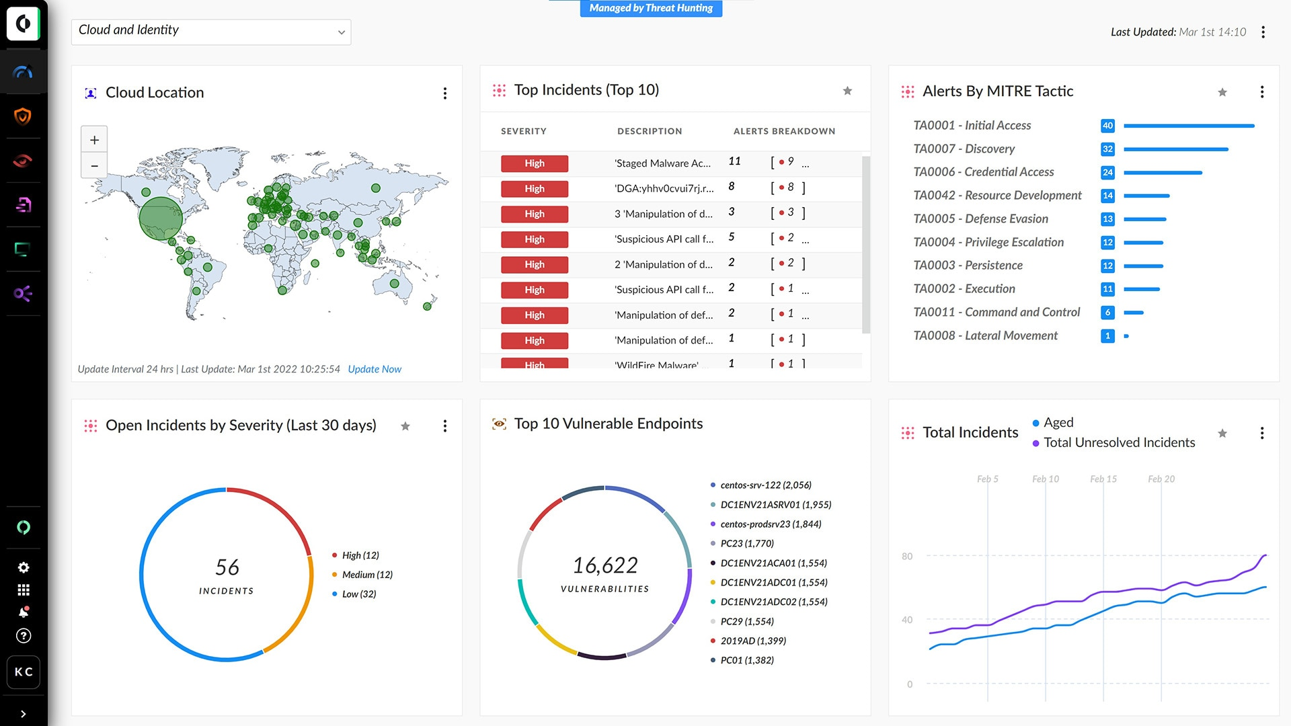
Notes:
Here is an image of the Cortex XDR dashboard, which is completely customizable. As you can see, there are very powerful charts and graphs that are generated automatically from collected data.

Slide 10
Cortex XDR - Pricing
Cortex XDR pricing must be discussed with a sales representative
According to peerspot.com, Cortex XDR costs approximately $55 to $90 a month
Notes:
Cortex XDR pricing must be discussed in a consultation with a sales representative, however, according to peerspot.com, Cortex XDR costs approximately $55 to $90 per month.

Slide 11
EnCase Endpoint Investigator - OpenText
Discreet off-network collection capability
Remote device access across geographies
Examine the entire data content stored on the target hard drive including encrypted data
Automated analysis results in accelerated investigations
Highlights
Triage remote systems to determine if any relevant information exists on the machine before performing a collection
Notes:
The last of my recommendations is that we invest in a forensics tool that can remotely capture memory and disk images. For this tool, I recommend using OpenText’s EnCase Endpoint Investigator. In addition to discreetly and remotely capturing memory and disk images, EnCase Endpoint Investigator can audit employee accounts from cloud sources including Microsoft 365 and collect data off-network. The evidence format of the EnCase Endpoint Investigator is court-accepted, meaning if there is a security breach, the evidence provided by this program will be accepted in court. This is extremely important for our legal standpoint in the case that there is a breach.
Some highlights listed on the OpenText website include accelerated investigations from automated analysis of data, the ability to examine all data on a target machine, including encrypted data, and finally you can even triage remote systems to determine if any relevant information exists on the machine, before you decide to perform a collection.

Slide 12
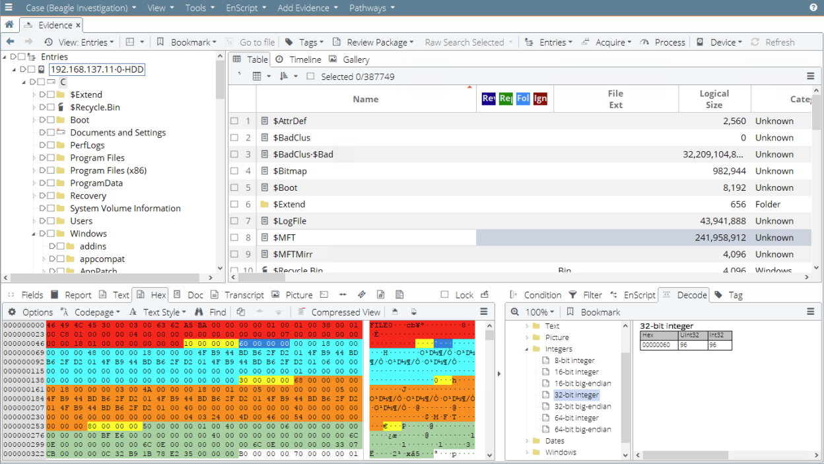
Notes:
Here is an image of EnCase Endpoint Investigator in action. Using EnCase Endpoint Investigator, you have remote access to laptops, desktops and servers that data can be captured discreetly.

Slide 13
EnCase Endpoint Investigator - Pricing
According to shi,com, EnCase Endpoint Investigator is $19,000
License covers 2,000 nodes
Notes:
According to shi.com, EnCase is quite pricey, however, as it costs around $19,000 for a license, but I would like to reiterate that 99% of detections are made in real-time using EnCase Endpoint Security. This license will cover up to 2,000 nodes which means there is plenty of growing room for our company.

Slide 14
References
IBM. Why is SIEM important? IBM. Retrieved November 3, 2022, from https://www.ibm.com/topics/siem#:~:text=SIEM%20solutions%20allow%20organizations%20to,implement%20more%20effective%20security%20processes.
IBM. IBM Security Qradar SIEM. IBM Retrieved November 3, 2022 from https://www.ibm.com/products/qradar-siem?utm_content=SRCWW&p1=Search&p4=43700068110904447&p5=p&gclid=EAIaIQobChMIs8HaxNqS-wIVyhTUAR3AyAzLEAAYASAAEgJ0WPD_BwE&gclsrc=aw.ds
IBM. IBM Security QRadar SIEM – Features. IBM. Retrieved November 3, 2022, from https://www.ibm.com/products/qradar-siem/features
Exterro. (n.d.). FTK® Forensic toolkit. Exterro. Retrieved October 31, 2022, from https://www.exterro.com/forensic-toolkit
G2. IBM Security QRadar. G2. Retrieved November 6, 2022, from https://www.g2.com/products/ibm-security-qradar/reviews
Cynet. What are Endpoint Detection and Response (EDR) Tools? Definitions, Features & Top 6 Tools [2022]. Cynet. Retrieved November 6, 2022, from https://www.cynet.com/endpoint-protection-and-edr/top-6-edr-tools-compared/
Palo Alto Networks. Cortex XDR. Retrieved November 6, 2022, from https://www.paloaltonetworks.com/cortex/cortex-xdr
Palo Alto Networks. What is endpoint detection and response? (EDR). Retrieved November 6, 2022, from https://www.paloaltonetworks.com/cyberpedia/what-is-endpoint-detection-and-response-edr
OpenText. Product Overview – OpenText EnCase Endpoint Investigator. Retrieved November 6, 2022, from https://www.opentext.com/assets/documents/en-US/pdf/opentext-po-encase-endpoint-investigator-en.pdf
PeerSpot. What is your experience regarding pricing and costs for Cortex XDR by Palo Alto Networks?. Retrieved November 6, 2022, from https://www.peerspot.com/questions/what-is-your-experience-regarding-pricing-and-costs-for-cortex-xdr-by-palo-alto-networks
Shi. EnCase Endpoint Investigator. Retrieved November 6, 2022, from https://www.shi.com/Products/ProductDetail.aspx?SHISystemID=ShiCommodity&ProductIdentity=32650985
Notes:
I have already emailed everyone a copy of this presentation, feel free to review any material that I’ve mentioned using the links on this reference page. Thank you all for attending this presentation!

